Slide 1
Strong but sparse inputs determine neuronal output via dendritic spikes
Arnd Roth
Wolfson Institute for Biomedical Research
University College London

Slide 2
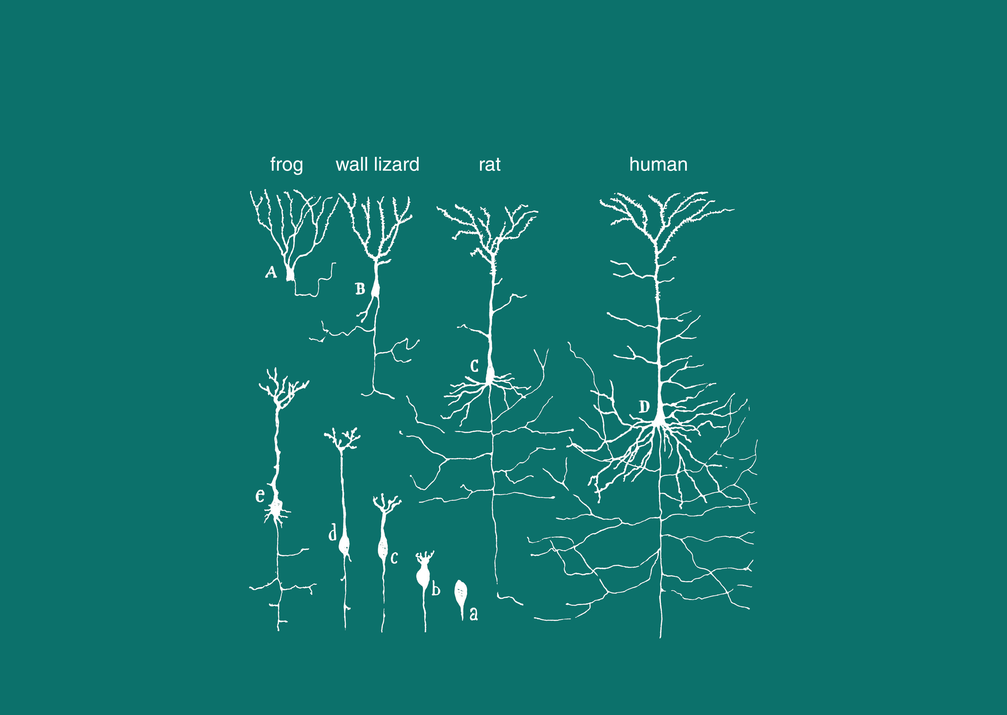
Pyramidal cell development in vertebrates
Cajal, 1894

Slide 3
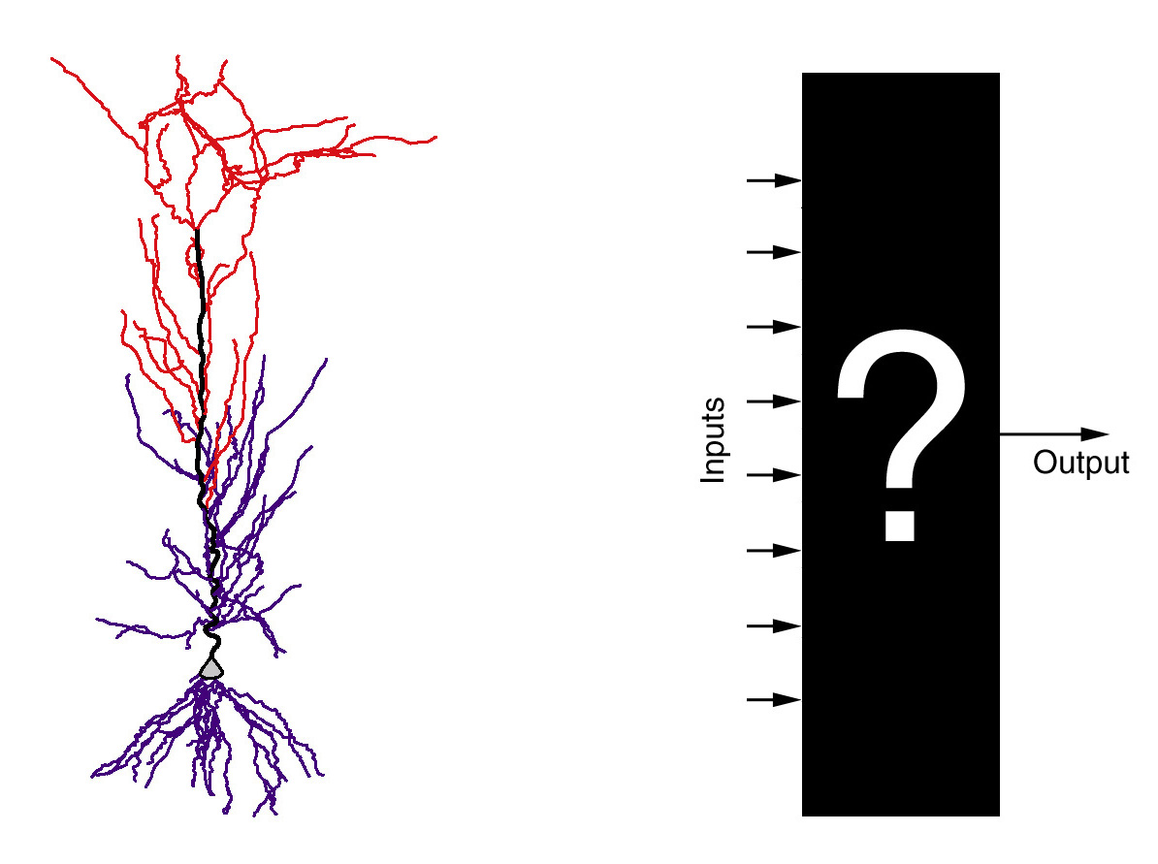
How do neurons transform synaptic inputs into action potential output?

Slide 4
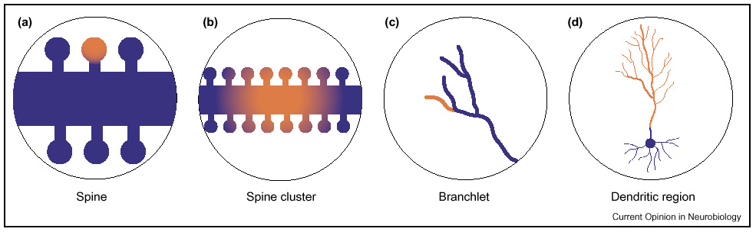
What are the functional compartments in neurons?

Slide 5
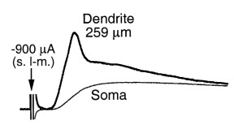
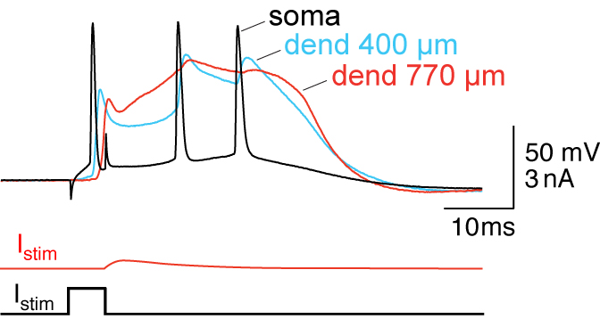
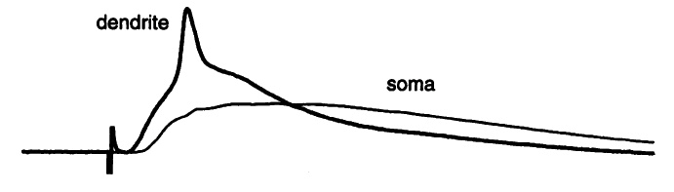
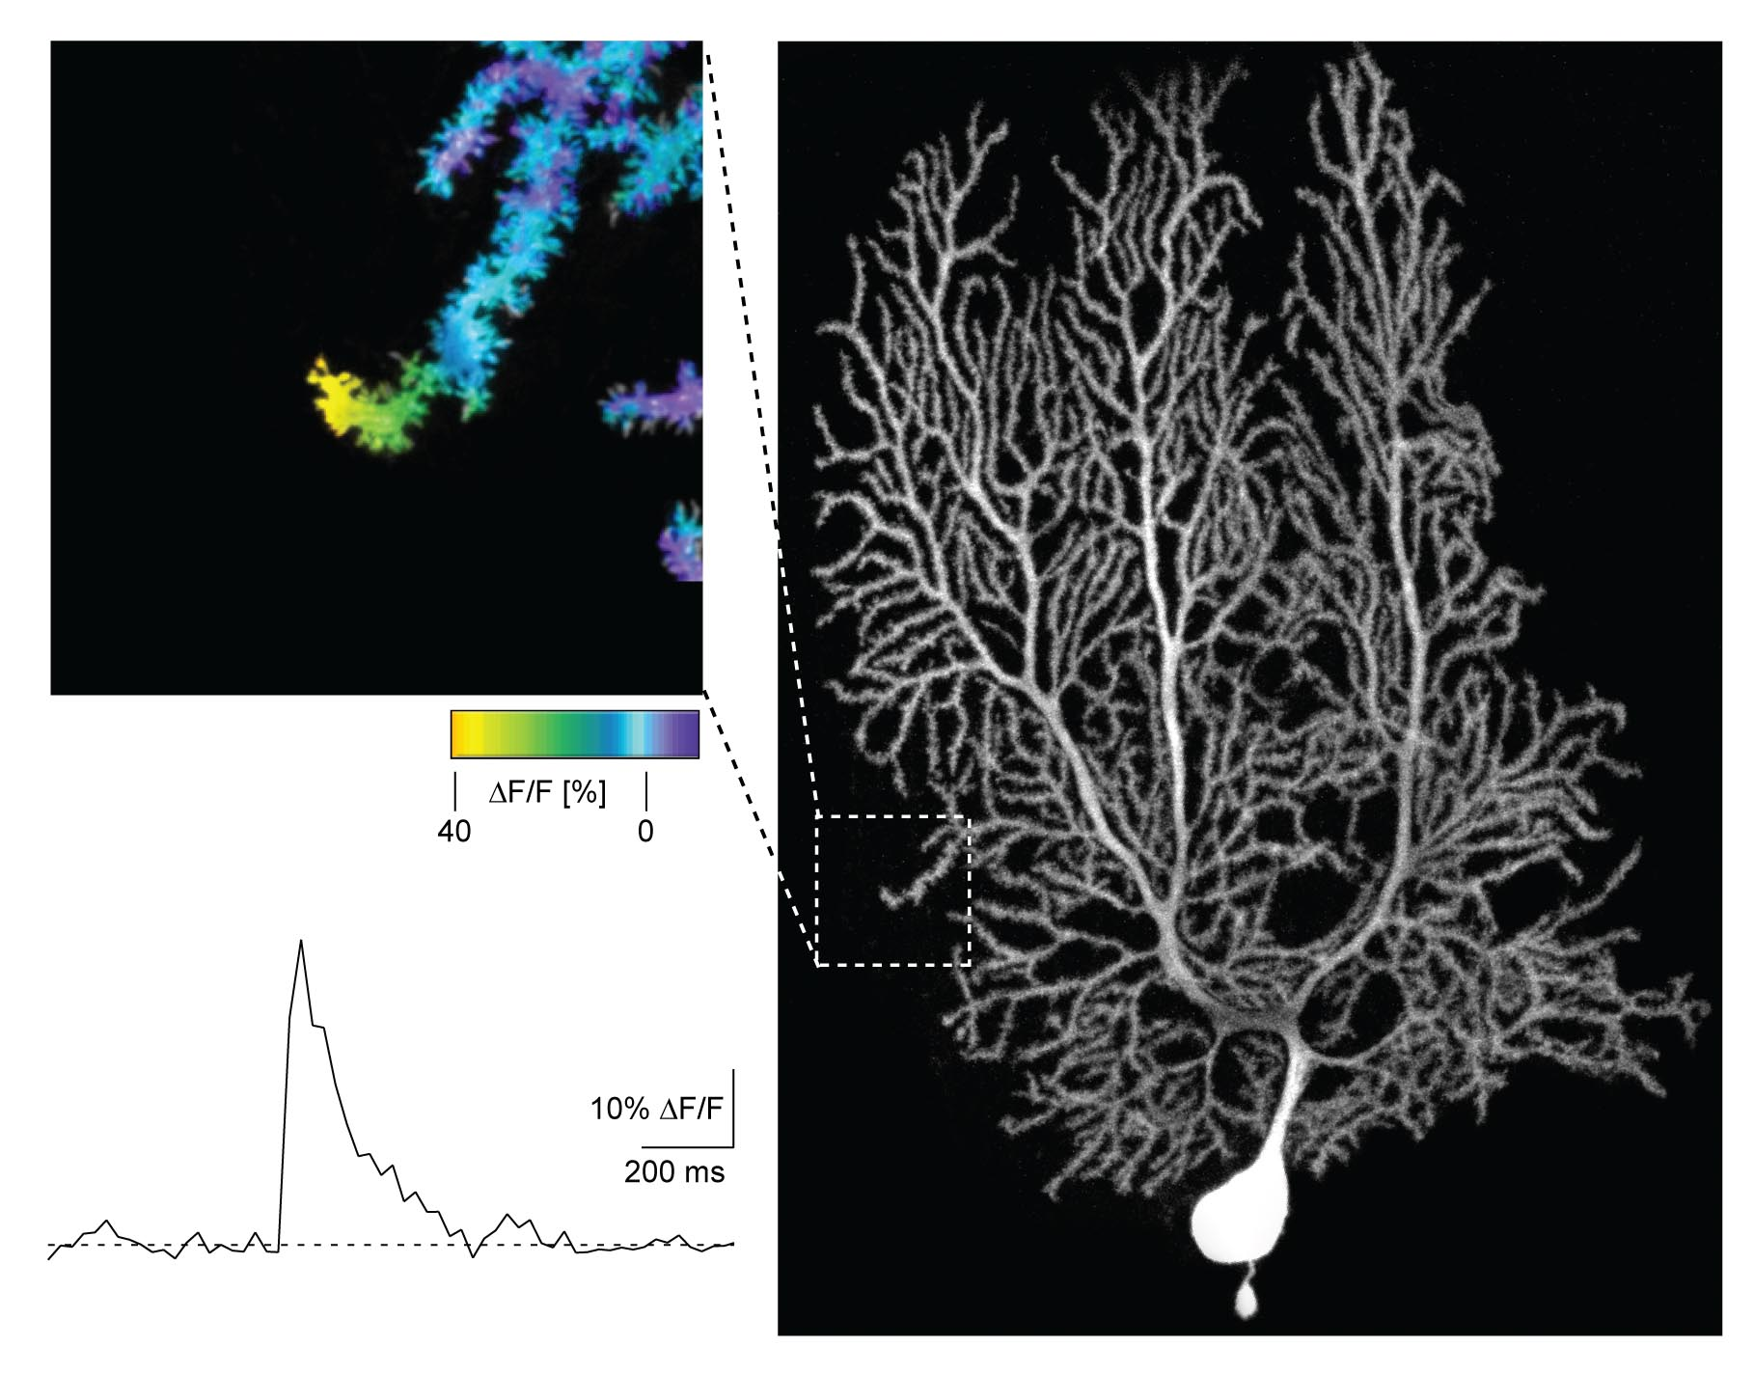
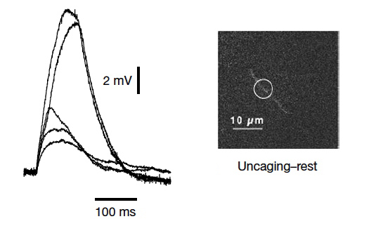
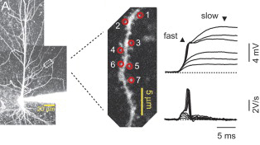
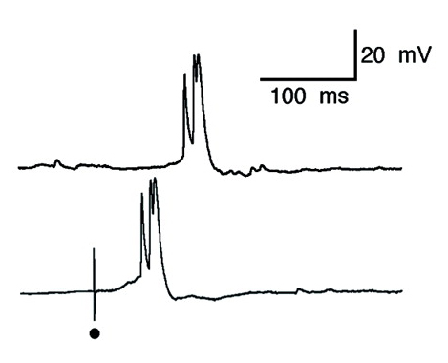
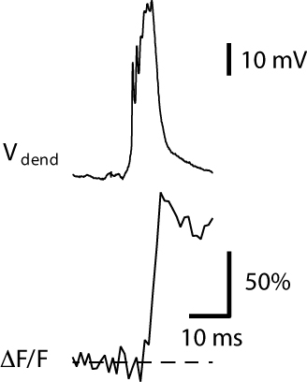
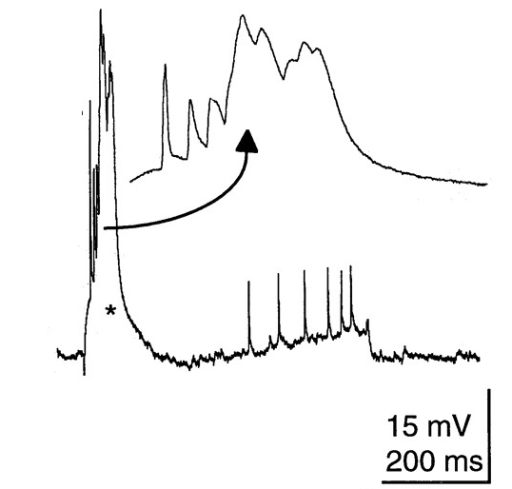
Pyramidal cell dendrites are active!
In vitro
Stuart et al. 1997
Golding & Spruston, 1998
Larkum et al. 1999
Eilers, Augustine, Konnerth, 1995
Schiller et al., 2000
Losonczy & Magee, 2006
In vivo
Kamondi, Acsady, Buzsaki, 1998
Helmchen et al., 1999
Zhu & Larkum, 2002

Slide 6
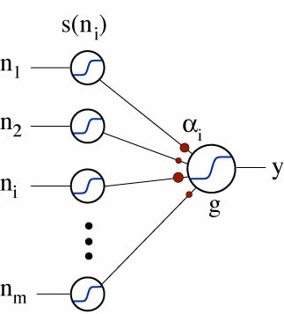
Dendritic nonlinearities can create independent processing compartments
=
soma
Σ
spikes
thin branch = subunit
Bartlett Mel
“One has to consider the possibility that in the monkey the simple-cell step may be skipped, perhaps by summing the inputs from cells in layer 4 on dendrites of complex cells. In such a scheme each main dendritic branch of a complex cell would perform the function of a simple cell.”
David Hubel, Nature 299: 515-524, 1982

Slide 7
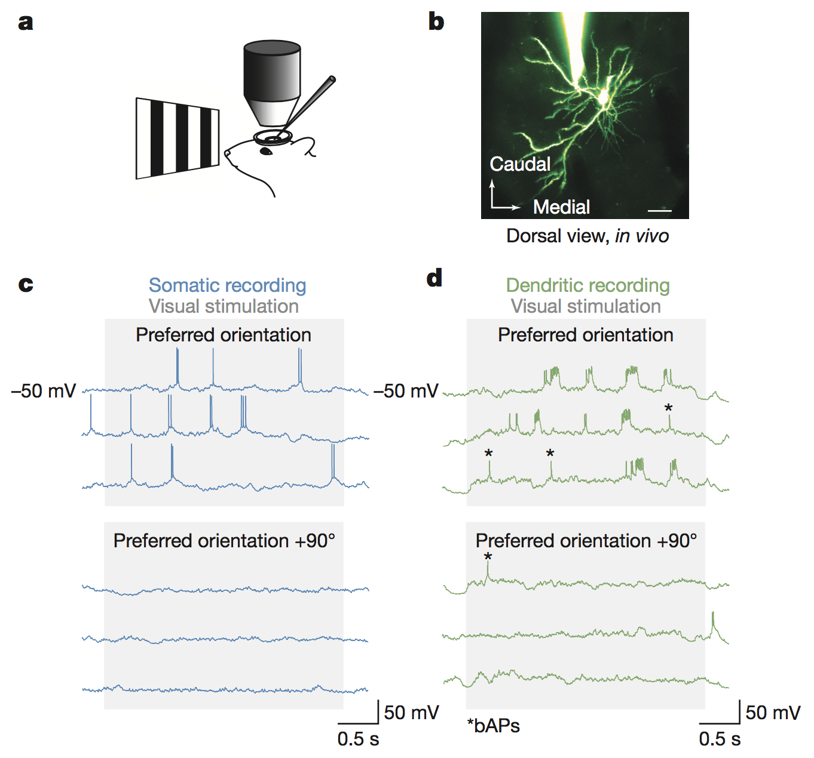
Dendritic spikes are selectively driven by visual input in vivo
Smith et al., Nature 2013
Notes:
I want to understand: how are these dendritic spikes generated from in vivo synaptic inputs? and how do dendritic spikes relate to action potential output?
to answer these questions, I built a biophysical model of a L2/3 pyramidal neuron and the synaptic input it receives in vivo.

Slide 8

Dendritic spikes are highly sensitive to orientation
90°
0°
180°
270°

Slide 9
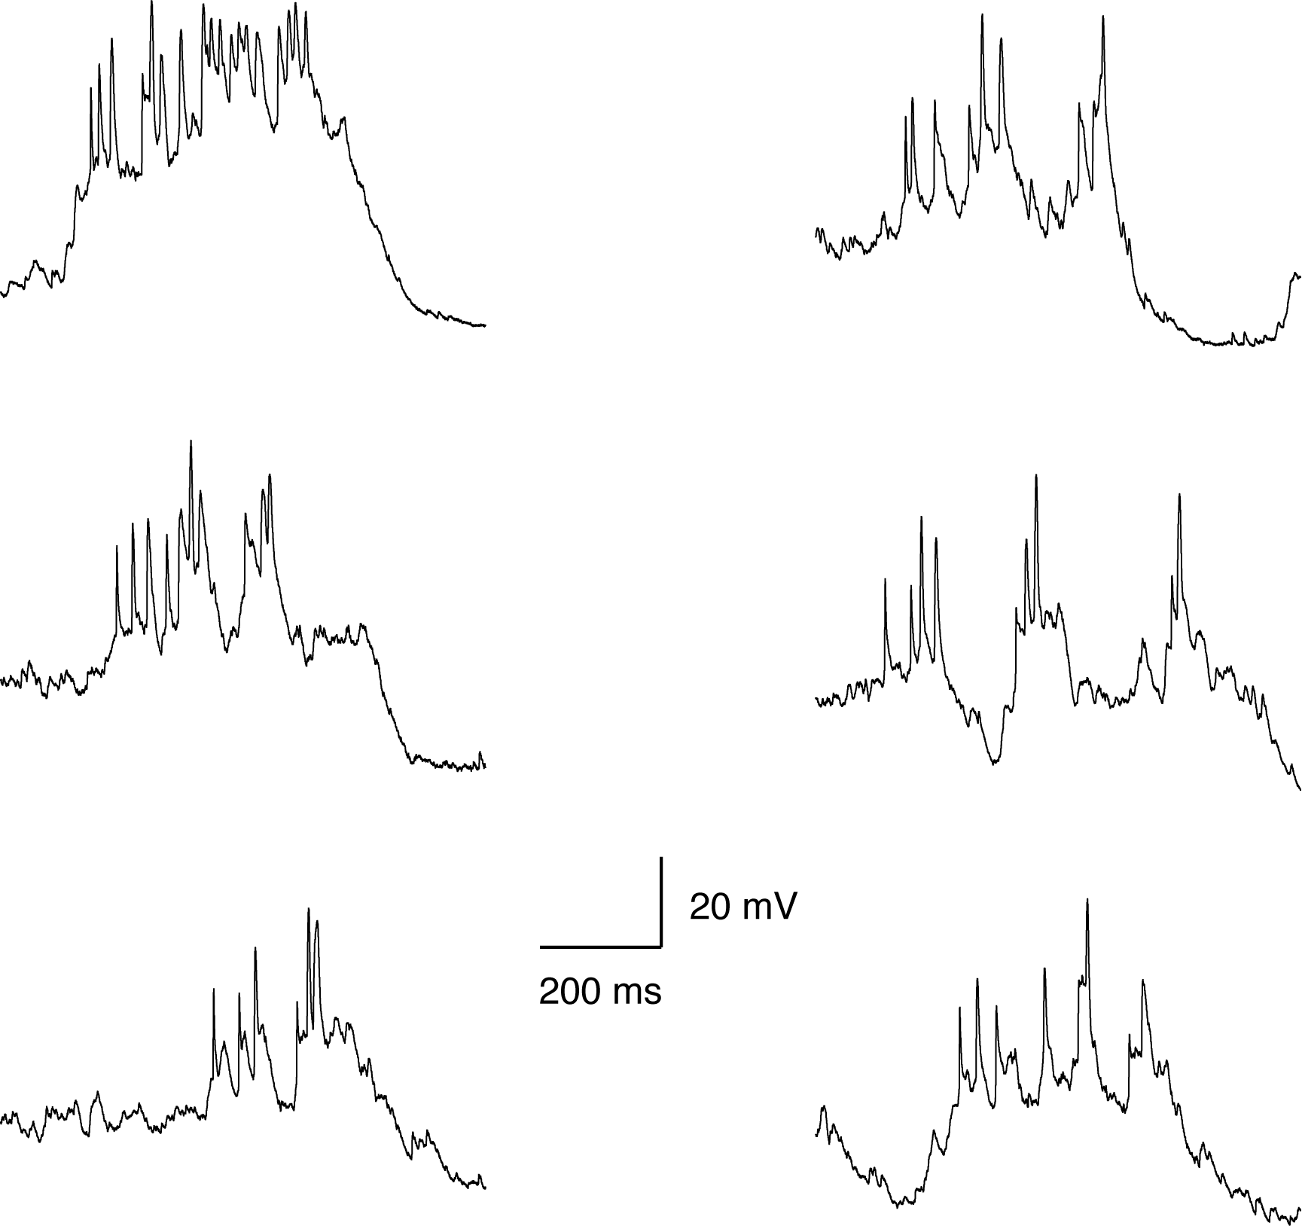
Visually evoked dendritic spikes have some unusual features
high rates
broad spikes
highly variable
amplitudes
broad spikes

Slide 10
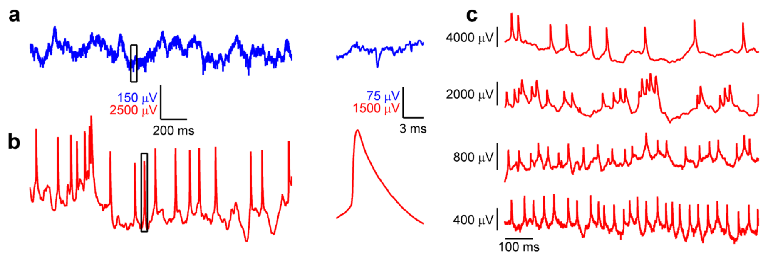
Similar dendritic events are seen in freely moving animals
Moore et al., Science 2017
Notes:
I want to understand: how are these dendritic spikes generated from in vivo synaptic inputs? and how do dendritic spikes relate to action potential output?
to answer these questions, I built a biophysical model of a L2/3 pyramidal neuron and the synaptic input it receives in vivo.

Slide 11
A variety of integration mechanisms in dendrites:
EPSP boosting, Na⁺ spikes, NMDA spikes, Ca²⁺ spikes …
for example: NMDA spike
… but which of these are engaged by synaptic inputs in vivo and how does this affect AP output – and thus sensory processing?
Notes:
For a long time people have recognized the potential of dendritic integration mechanisms to enhance the computational capabilities of the neuron and speculated about their function. But for none of these (NMDA spikes, Na spikes, boosting, etc …) has anyone been able to demonstrate a (causal) mechanism by which they actually influence the function of the neuron in vivo. The function we are interested in is orientation tuning and the mechanisms we study are dendritic Na and NMDA spikes.

Slide 12

Lea Goetz

Slide 13
Questions
What determines the output of a layer 2/3 pyramidal neuron in V1?
Which synaptic input patterns engage dendritic spikes in vivo?
What is the influence of synaptic inputs – via dendritic spikes – on the output of the neuron?

Slide 14
An active biophysical model with in vivo-like input
Goetz et al., PNAS 118, e2017339118 (2021)

Slide 15
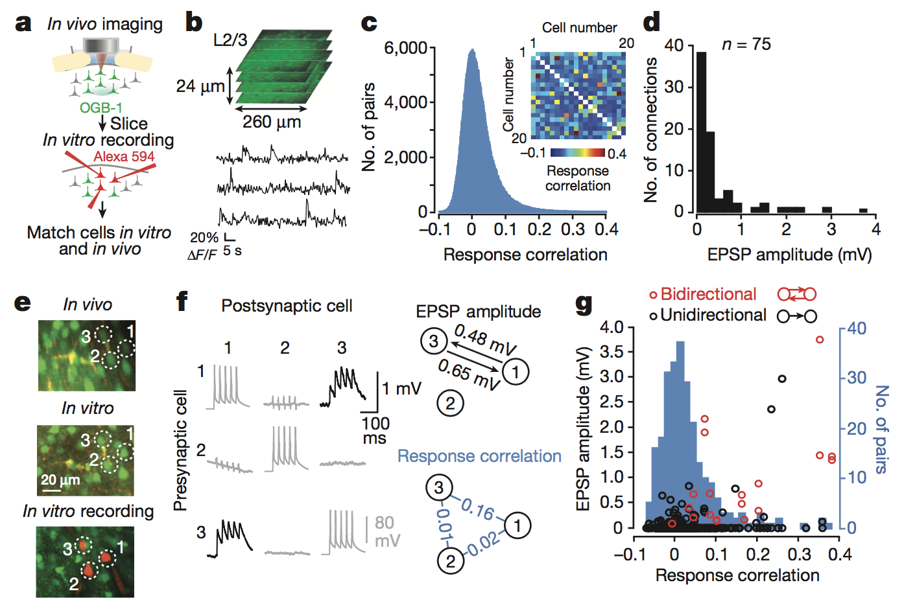
Connection strength reflects response similarity in vivo
Cossell et al., Nature 2015

Slide 16
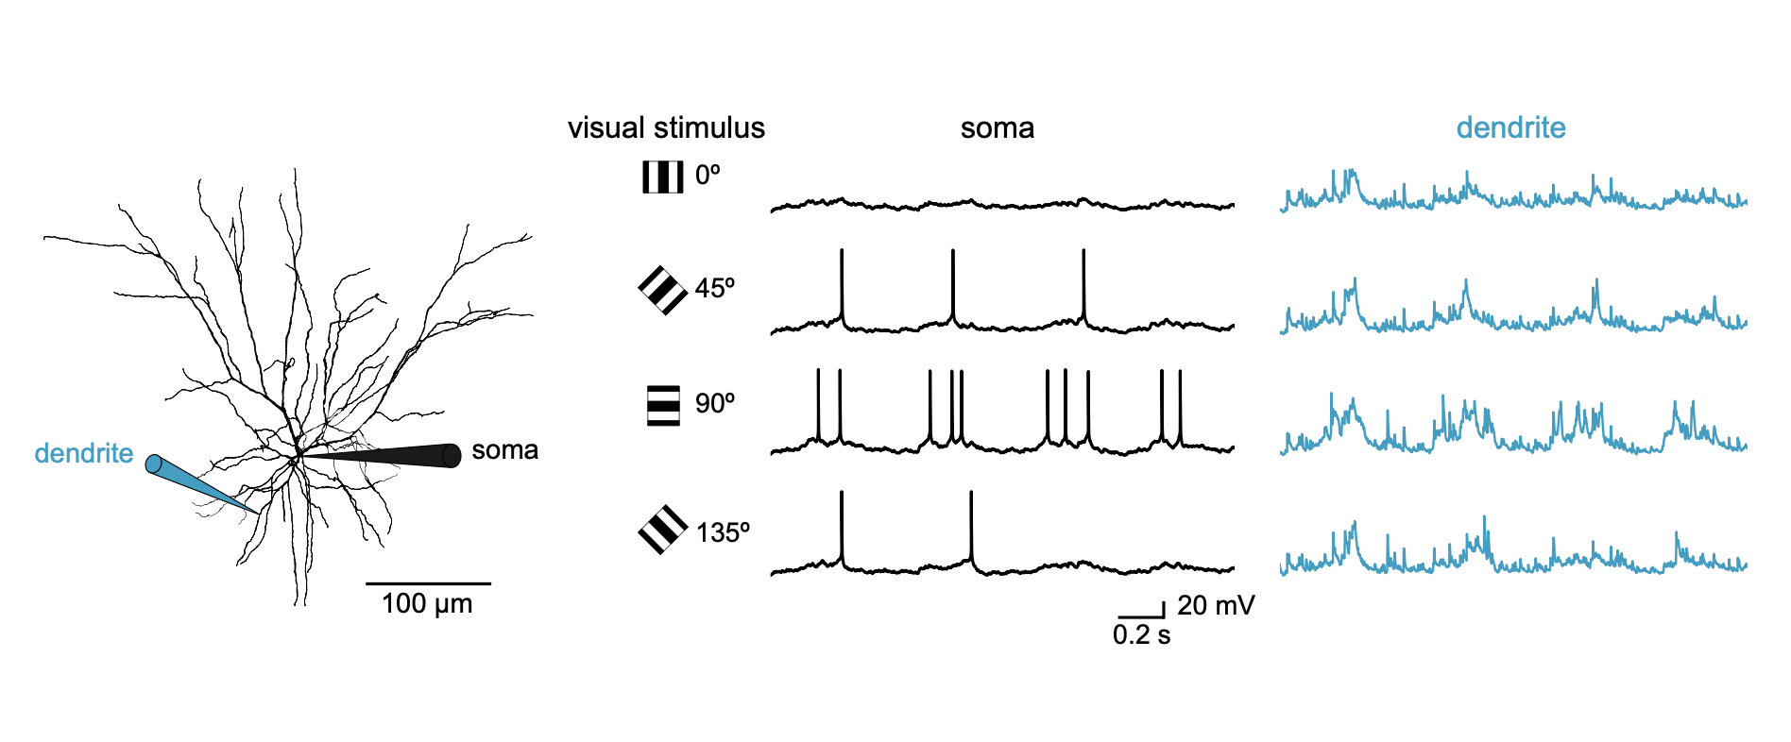
The model reproduces responses to visual stimulation
as observed in vivo

Slide 17
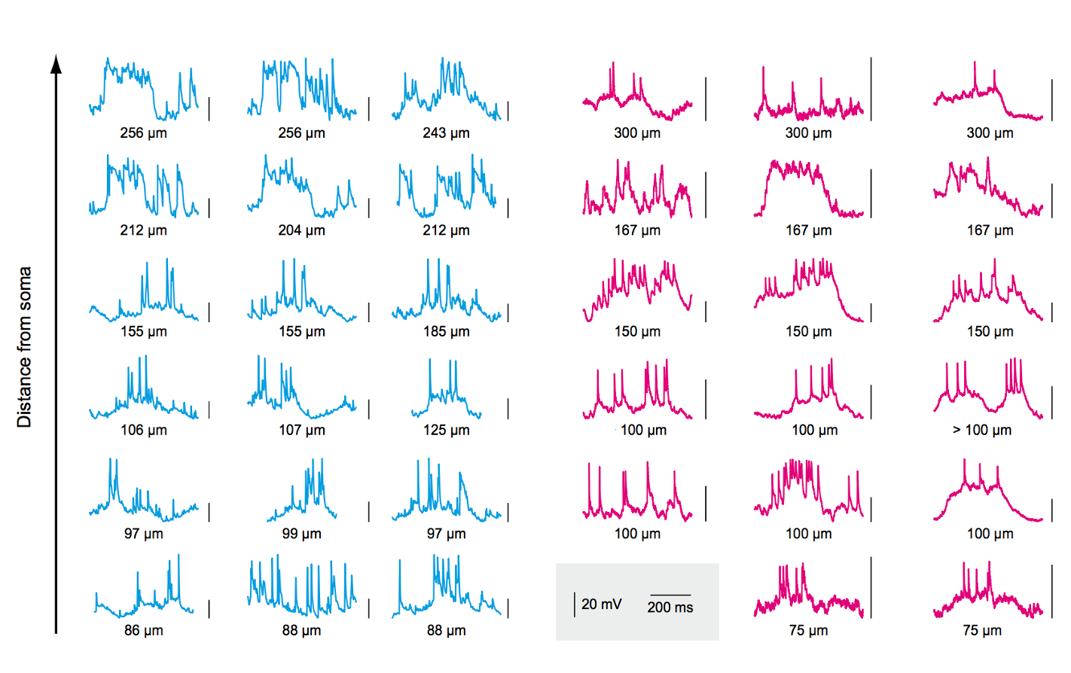
The model reproduces responses to visual stimulation
as observed in vivo

Slide 18
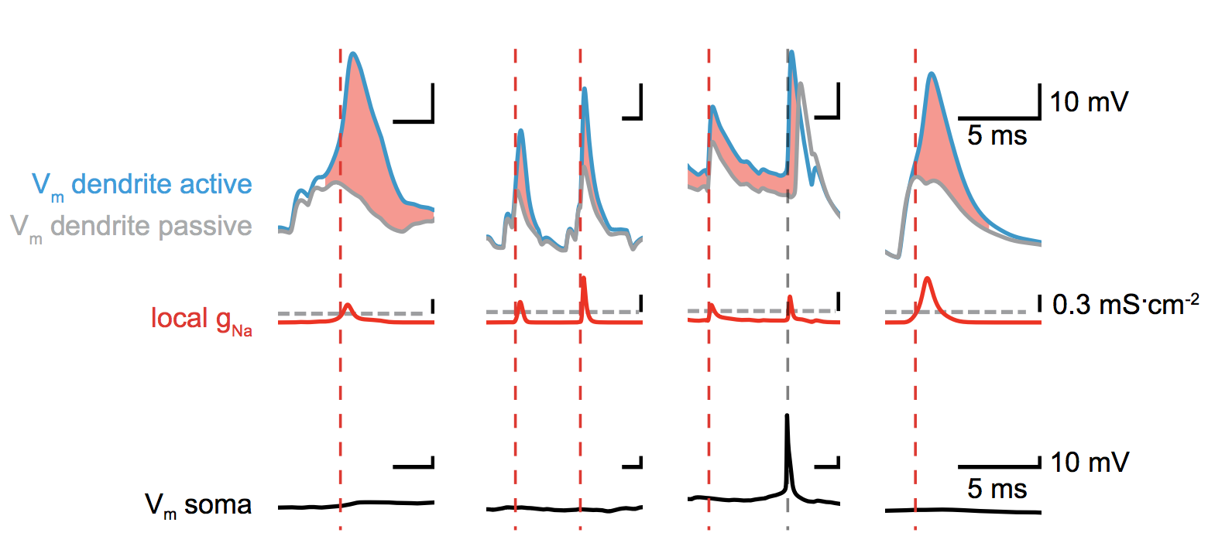
A detector for dendritic sodium spikes

Slide 19
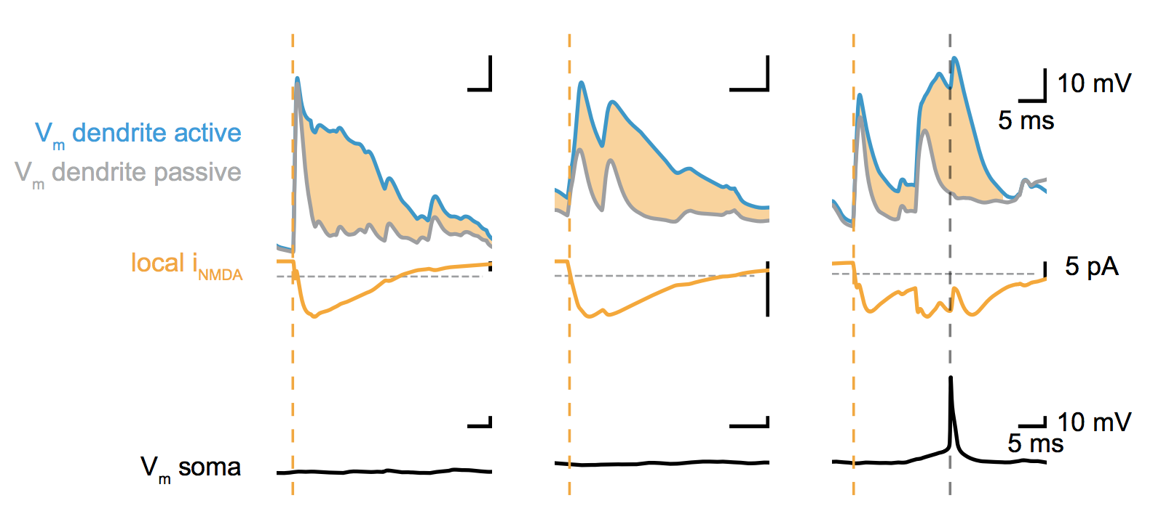
A detector for dendritic NMDA spikes

Slide 20
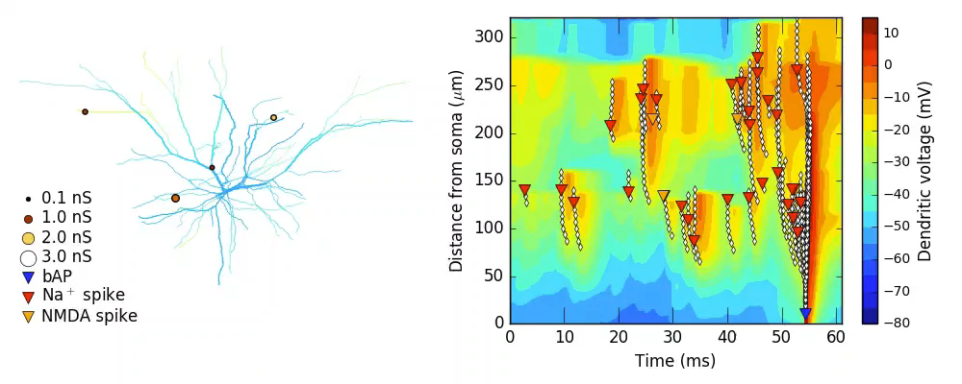
Dendritic Na⁺ spikes and NMDA spikes precede AP output

Slide 21
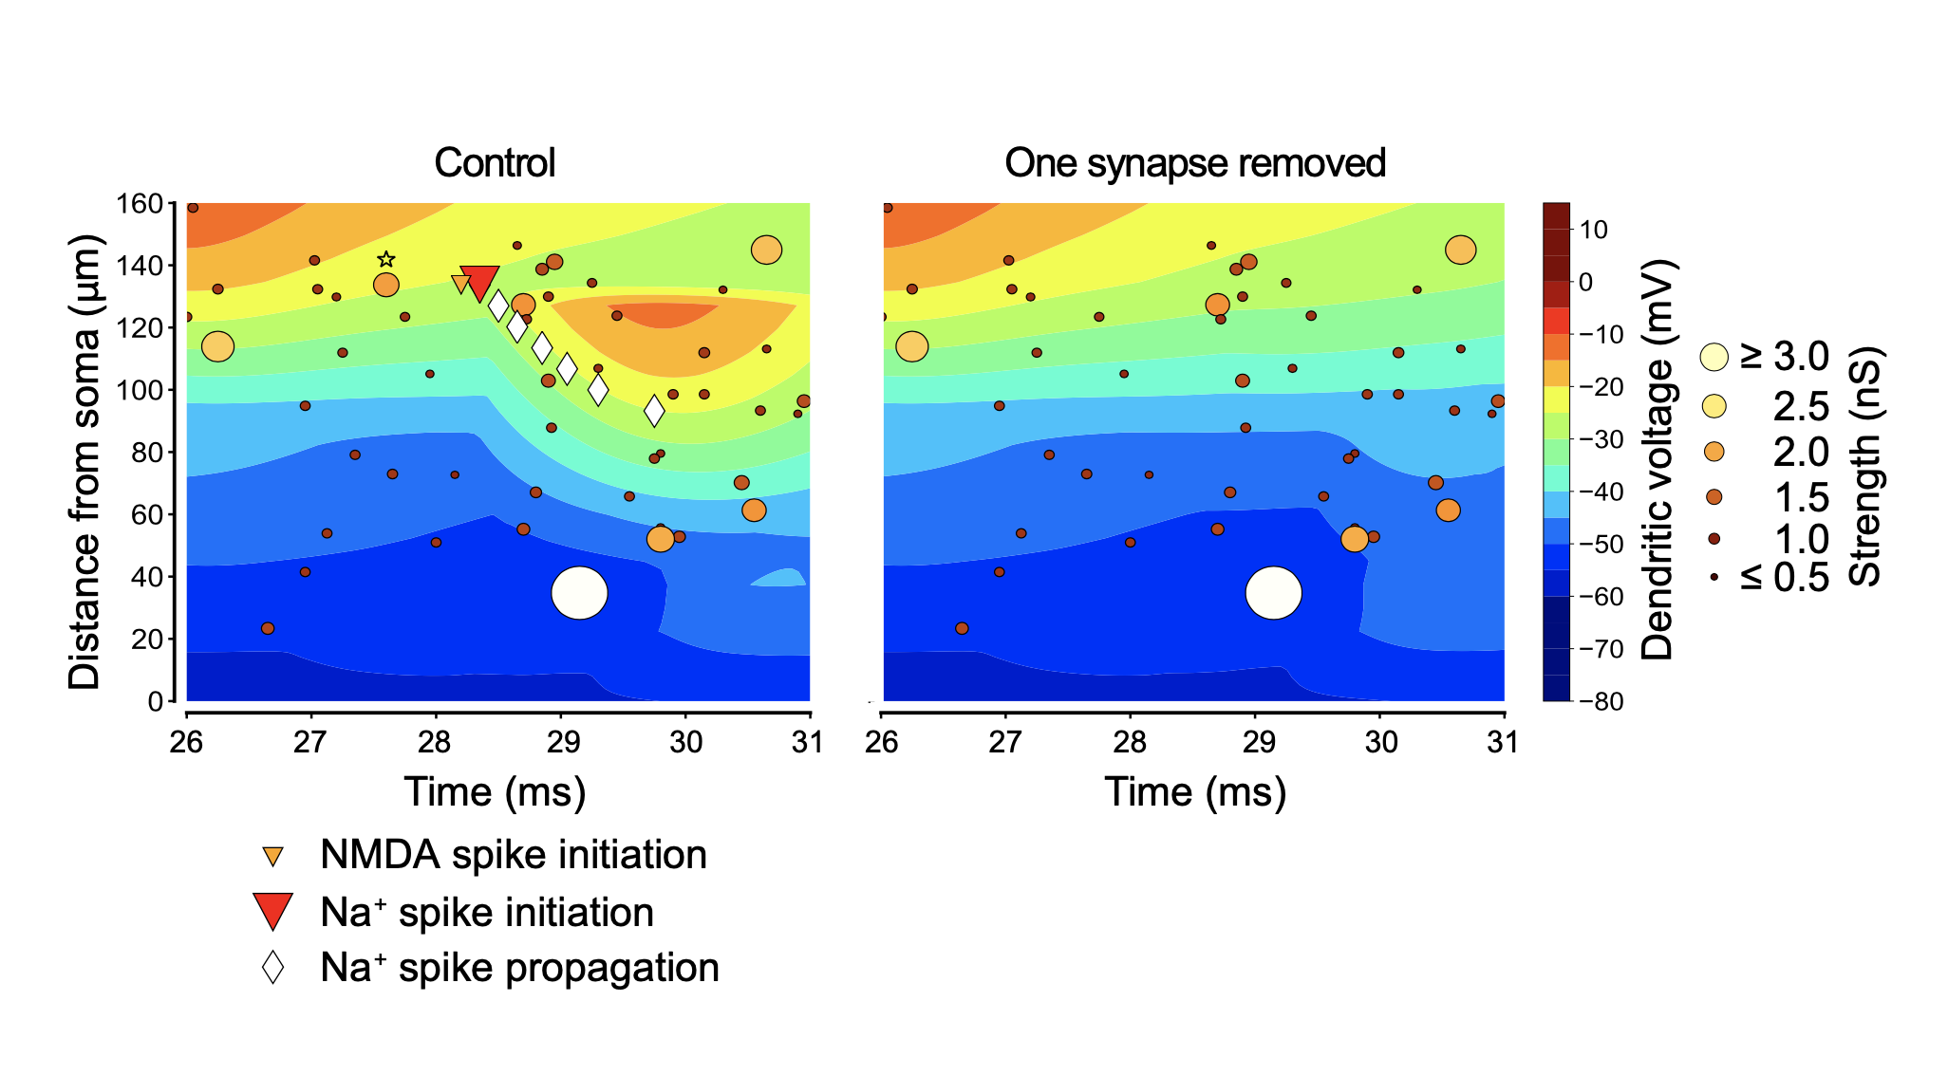
Strong but sparse synaptic inputs trigger dendritic spikes

Slide 22
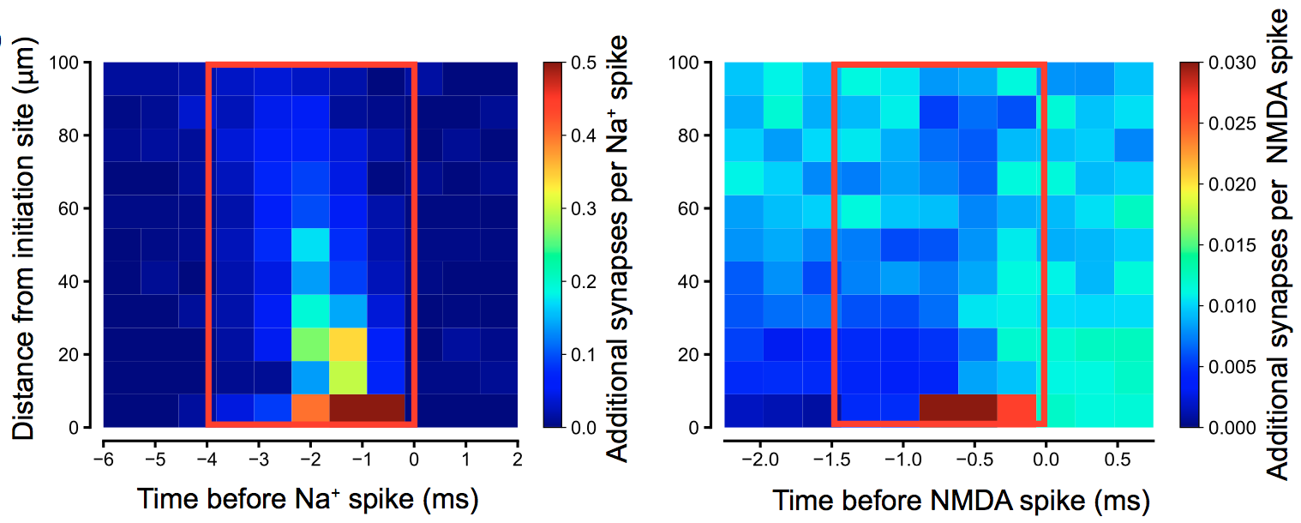
Strong but sparse synaptic inputs trigger dendritic spikes

Slide 23
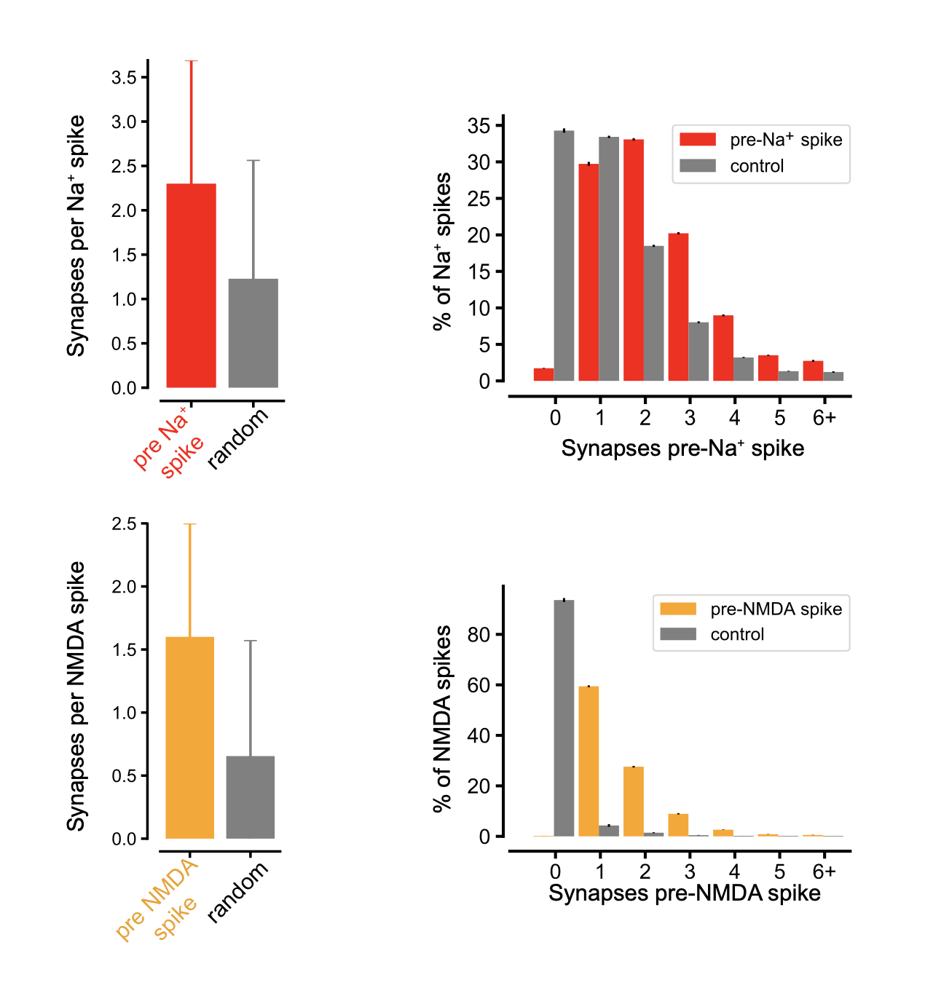
Strong but sparse synaptic inputs trigger dendritic spikes

Slide 24
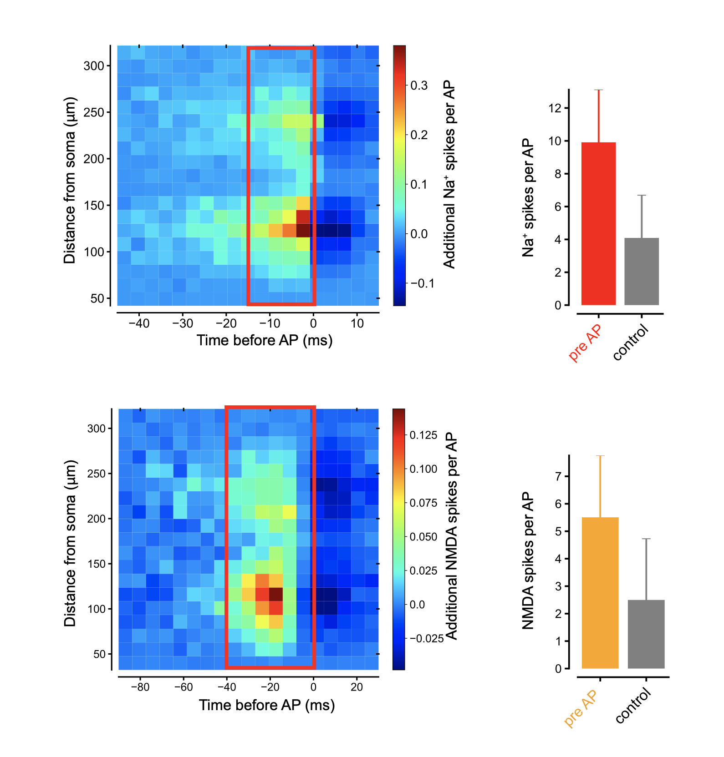
Dendritic Na⁺ spikes and NMDA spikes precede AP output

Slide 25
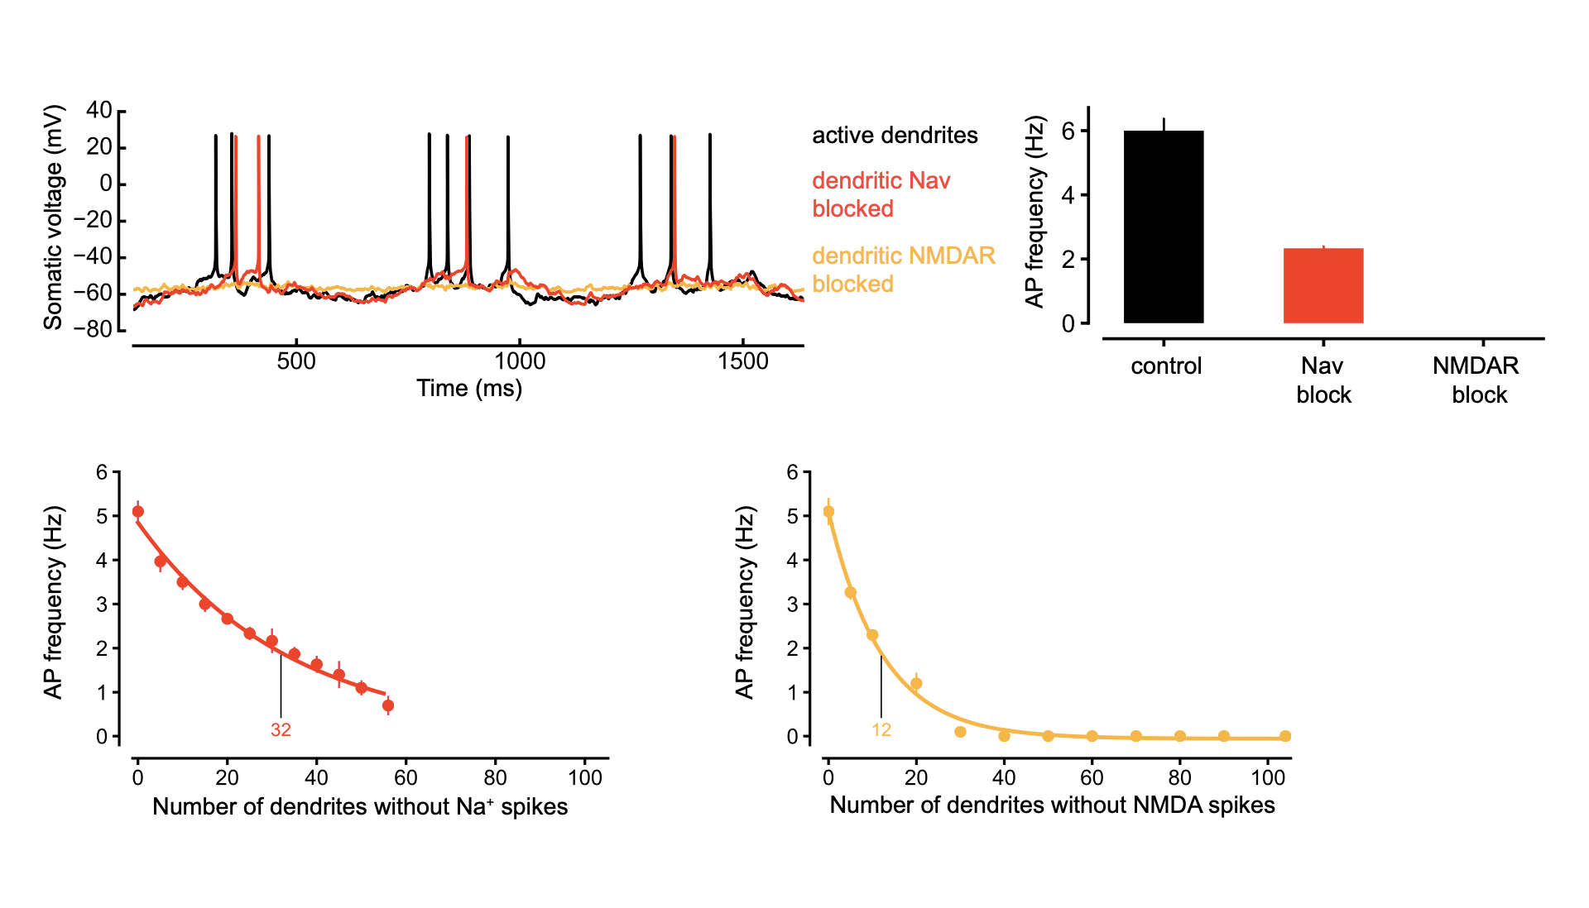
Dendritic NMDA and Na⁺ spikes determine action potential output

Slide 26
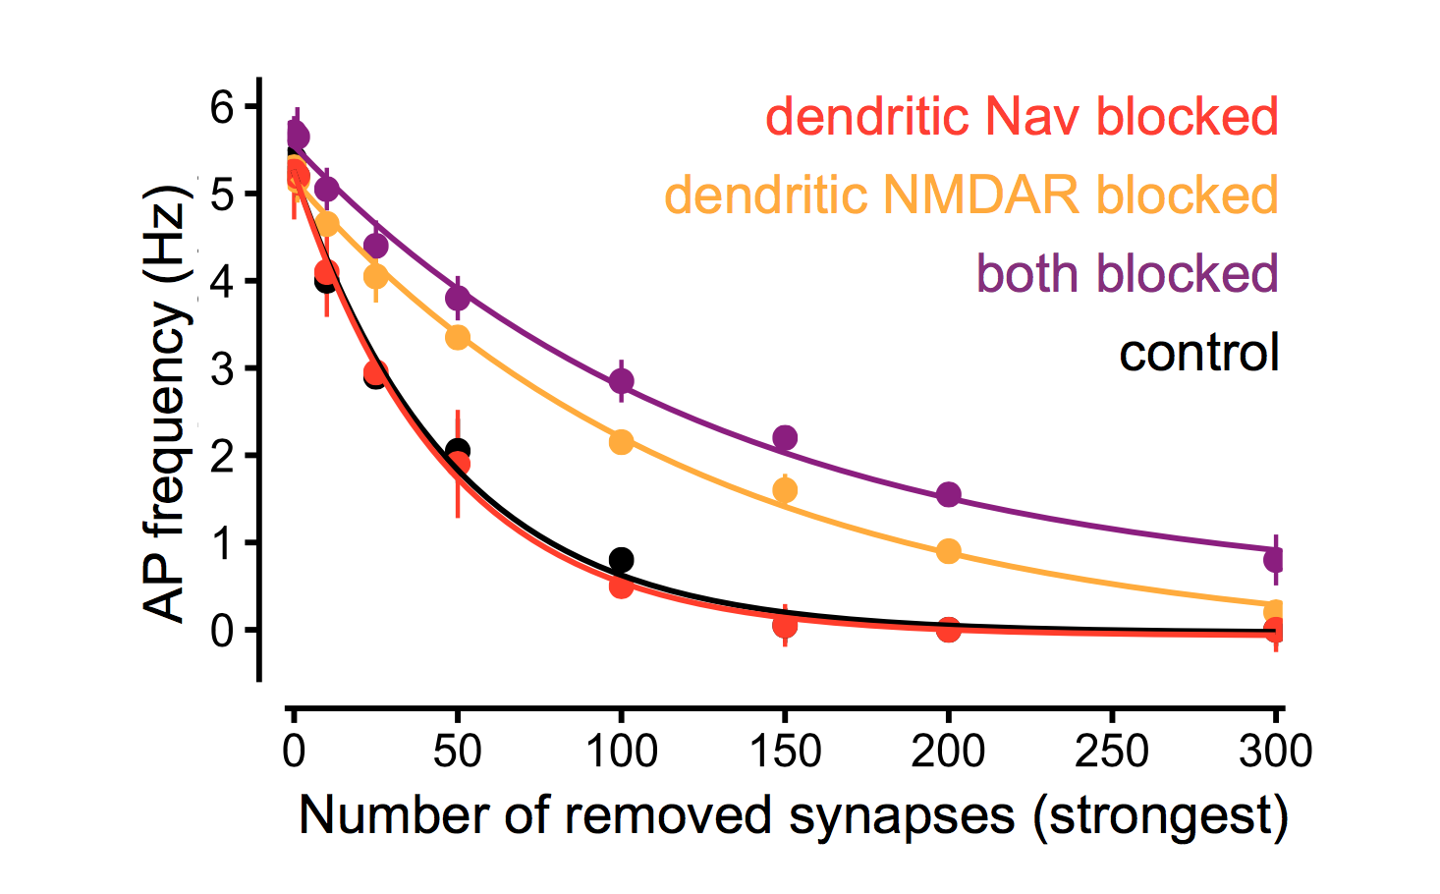
Dendritic spikes enable the strongest synapses to control action potential output and its orientation tuning
Notes:
- why do few strong synapses determine the NMDA spikes in dendrite 6 but the weak synases determine the NMDA spikes in dendrite 29?

Slide 27
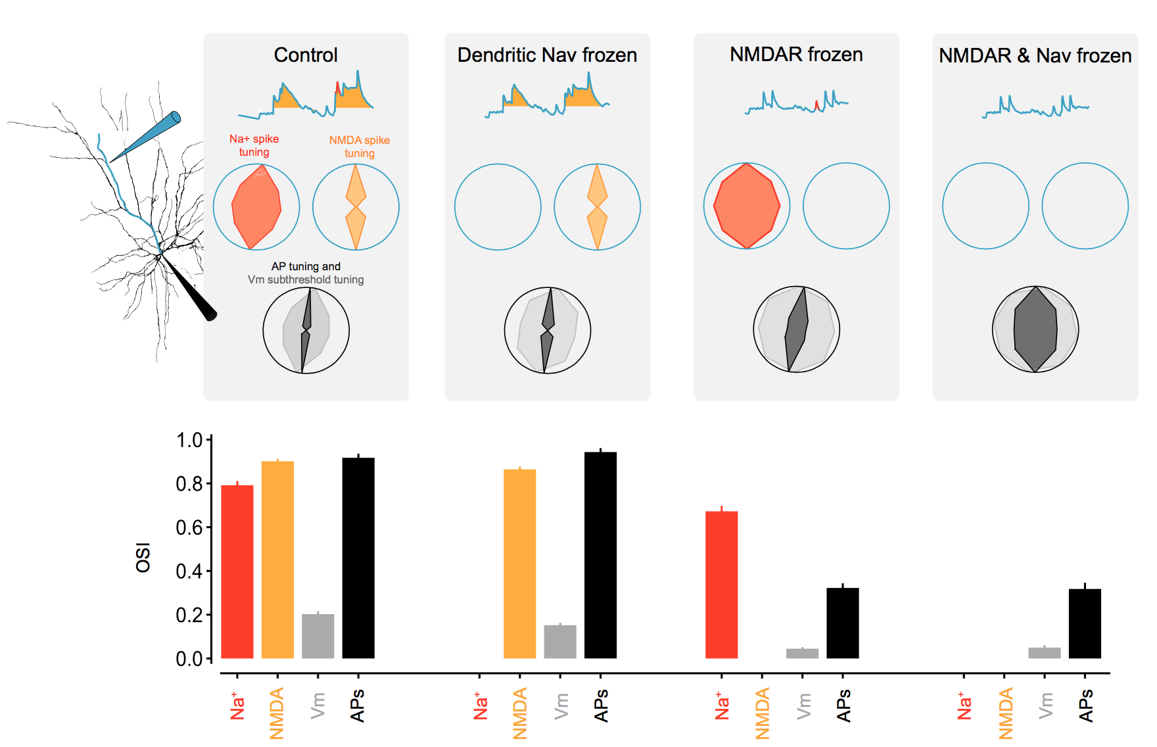
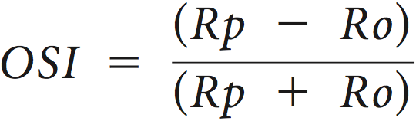
Dendritic spikes enable the strongest synapses to control action potential output and its orientation tuning
Notes:
- why do few strong synapses determine the NMDA spikes in dendrite 6 but the weak synases determine the NMDA spikes in dendrite 29?

Slide 28
Conclusions
What determines the output of a L2/3 pyramidal neuron in V1?
→ NMDA (and Na⁺) spikes determine the output of the neuron
Which synaptic input patterns engage dendritic spikes in vivo?
→ A small number of strong local synapses can trigger dendritic spikes in vivo
What is the influence of synaptic inputs – via dendritic spikes – on the output of the neuron?
Strong synaptic inputs, amplified by dendritic spikes, determine the output of the neuron

Slide 29
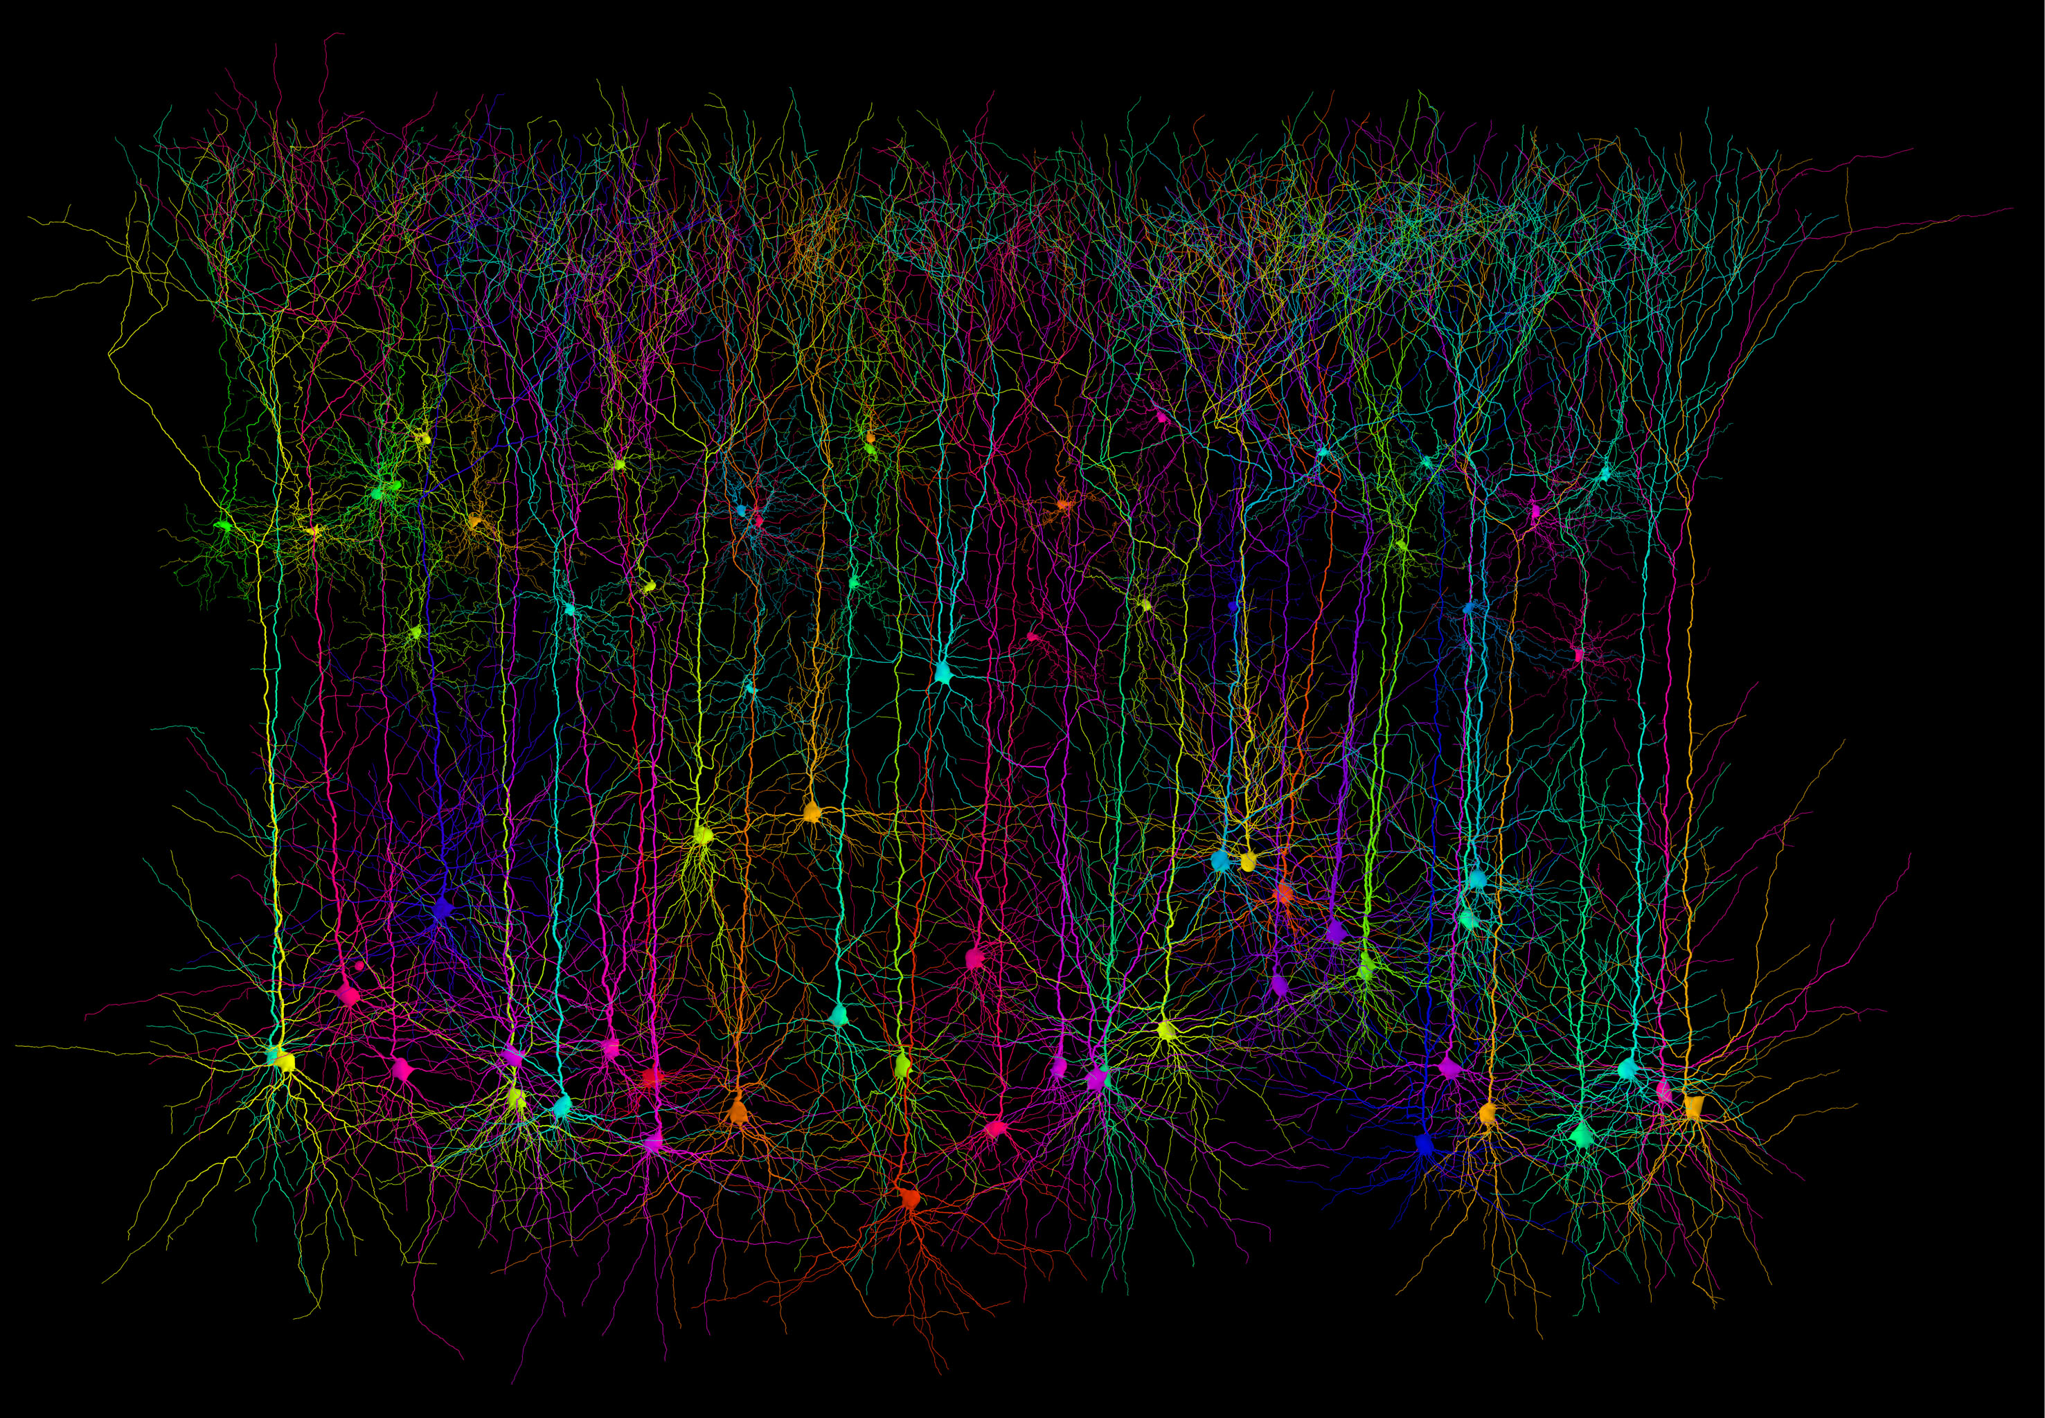



Thanks!
Lea Goetz (now GSK.ai)
Michael Häusser
Spencer Smith (now UCSB)
Ikuko Teramitsu Smith (now UCSB)
Tiago Branco (now SWC at UCL)
www.dendrites.org
Hermann Cuntz

Slide 30
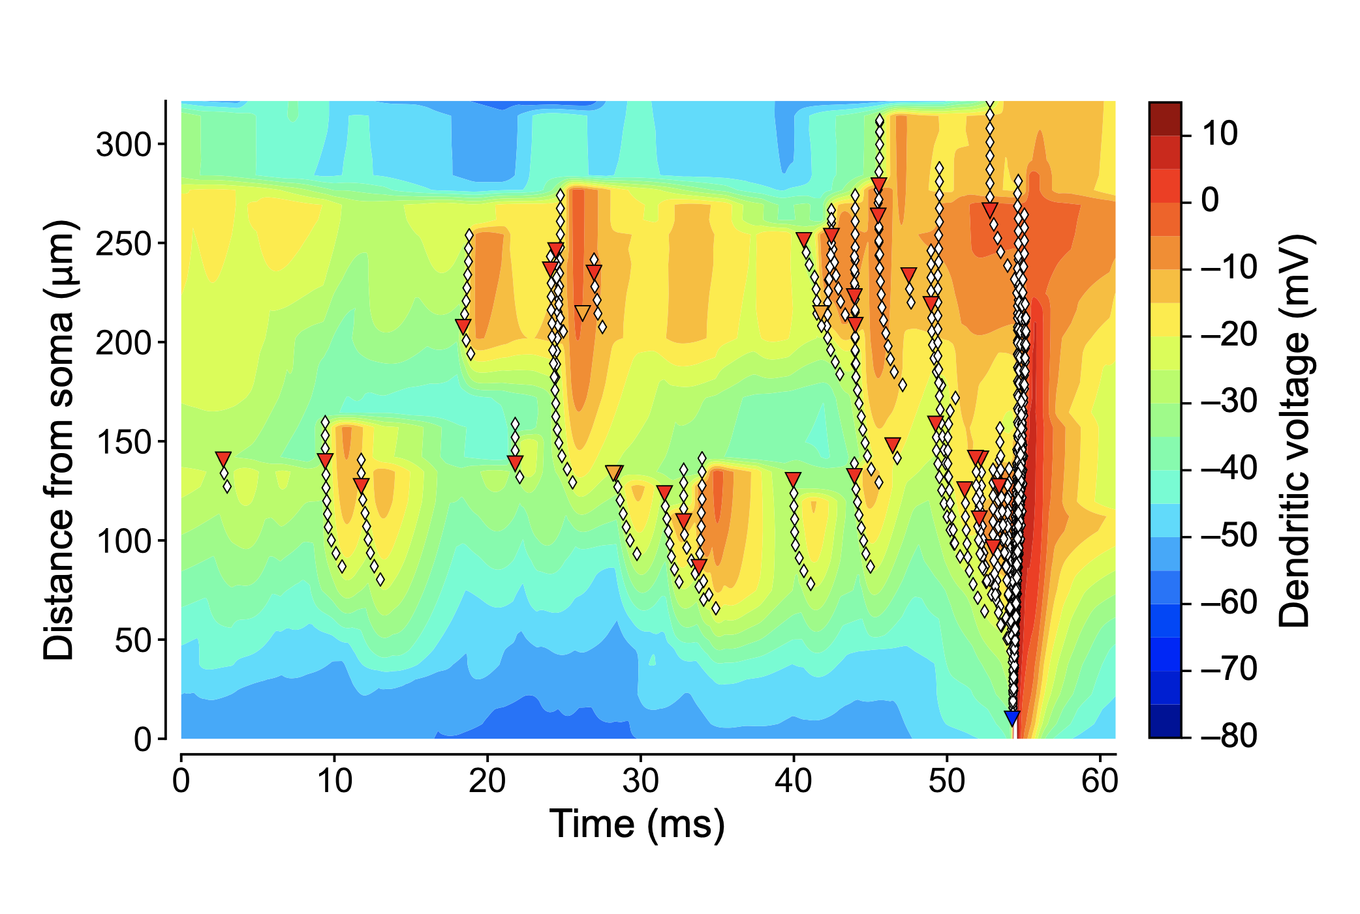
Dendritic Na⁺ spikes and NMDA spikes precede AP output

